Slide 1


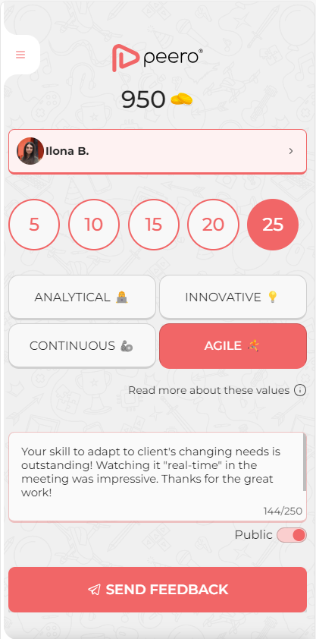
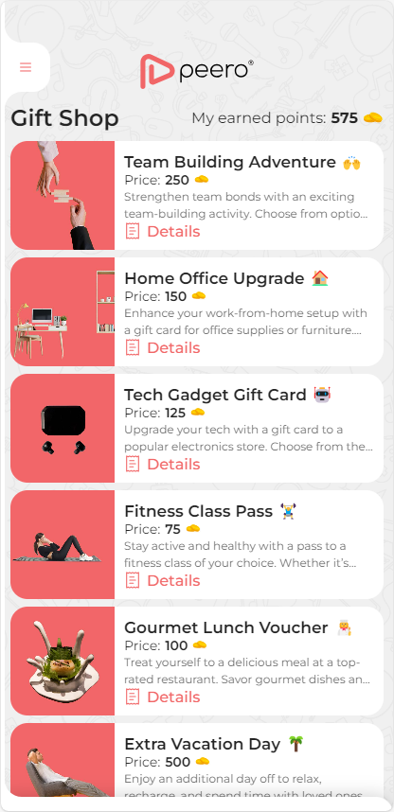

Through technology to values!

Slide 2
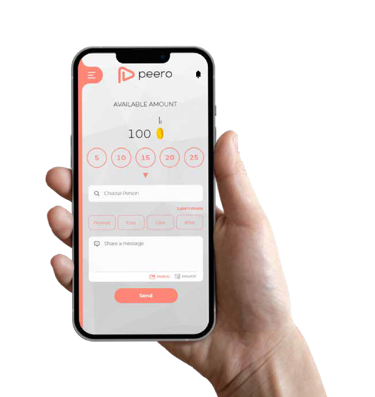
Peero is an application to say
Thank You
To colleagues for an extra service, prompt delivery, care or over exceeded expectations in alignment with corporate values & goals.

Slide 3





A sense of unity and belonging
Colleagues positively value my work with meaningful recognitions!
Company’s values align with my personal value!
Team spirit is strong, and we celebrate achievements!

Slide 4

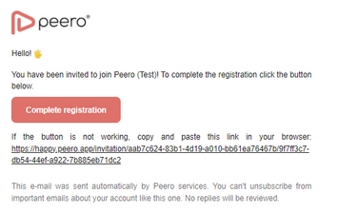
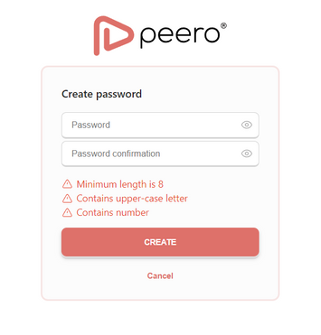

How to Access Peero Platform [Excel or manual import]
1.
Receive Email Invitation
2.
Create and Confirm Password
You will receive an email with a link to the Peero portal.
Set a secure password and confirm it to proceed.
Click on the “Create” button to complete the process.
Click on the “Complete Registration” button.

Slide 5
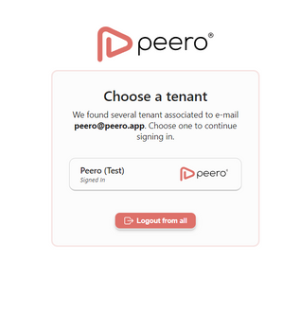
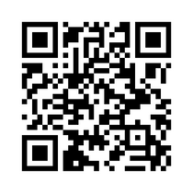
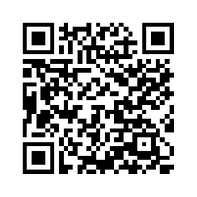



How to Access Peero Platform [Excel or manual import]
3.
Access Your Profile
4.
Download the Mobile App
Visit happy.peero.app to access your profile. Use your e-mail and password to sign in.
Download the Peero app on your mobile device for the best experience.
Choose your company tenant and access Peero.

Slide 6
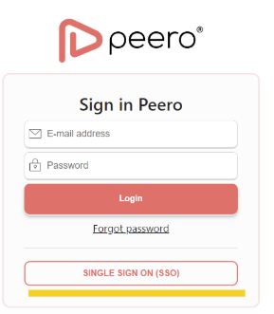
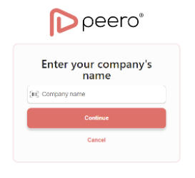
How to Access Peero Platform [AAD import]
1.
Visit the Platform
2.
Enter Your Company Name
Open happy.peero.app in your web browser,
Type in your company name:
Click on the “SINGLE SIGN ON (SSO)” button.

Slide 7
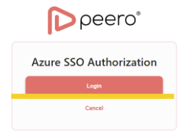
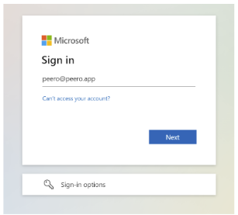
How to Access Peero Platform [AAD import]
3.
Log In
4.
Download the Mobile App
Click on the “Login” button.
Download the Peero app on your mobile device for the best experience.
Use your work account password (Microsoft password) to sign in.

Slide 8
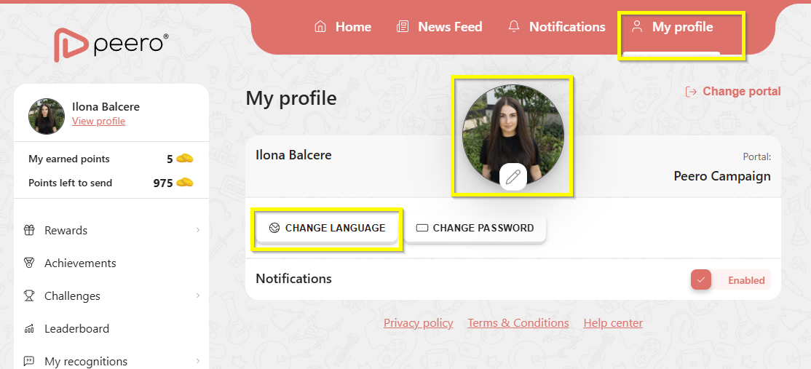
Before Start Using Peero
Go to the ‘My Profile’ section and add your picture so that colleagues can easily find and recognize you when sending acknowledgments! You can also change the app’s language if the default language is not your preferred one.

Slide 9






Simple Rules of Recognition Game
On the first date of each month, you will receive 100 points, you give those points to your teammates to recognize great work!
How to share coins?
25 points – maximum amount you can give to the same colleague during month
Unused coins will be lost! Make sure to share your all your coins until end the month
5
10
15
20
25
For small daily tasks in which a colleague has helped you
Signiﬁcant contribution to your and/or team's work
A colleague has shown special initiative and has done much more than was expected

Slide 10
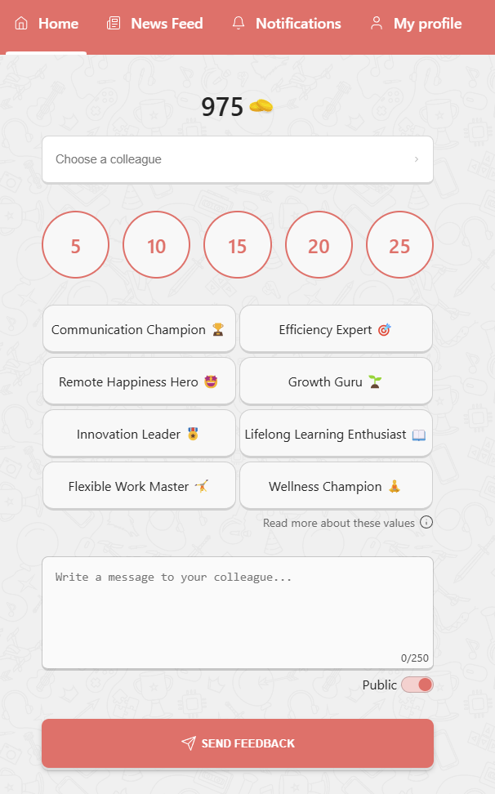
To Send Recognition
1
Select a colleague
Choose reward amount
Associate expressed value
Write a meaningful message
Send public or private Thanks
1
2
2
3
3
4
5
4
5

Slide 11
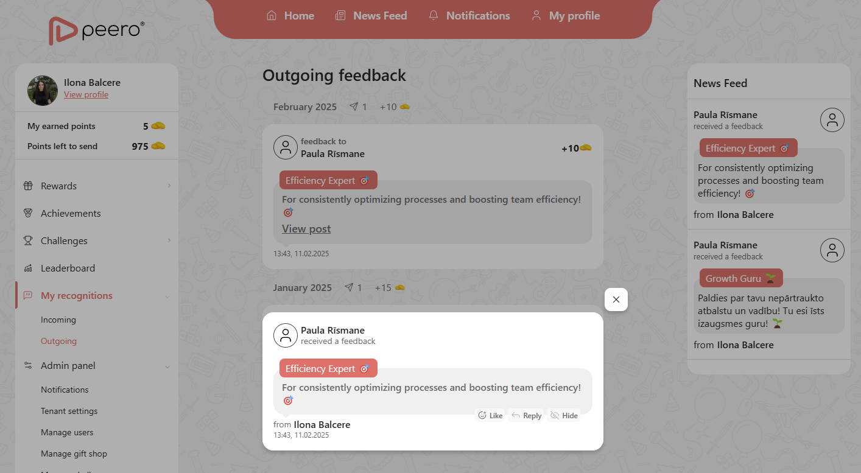
When Receiving Recognition
When you receive recognition, you will get a notification! Go to the app and see which colleague sent you the appreciation and for which organizational value this appreciation is.
3
Check received Thanks in “My recognitions” > Incoming section
Reply and react to received recognition
Follow all recognitions in News Feed, leave your comments and react
3
1
2
3
2
1

Slide 12
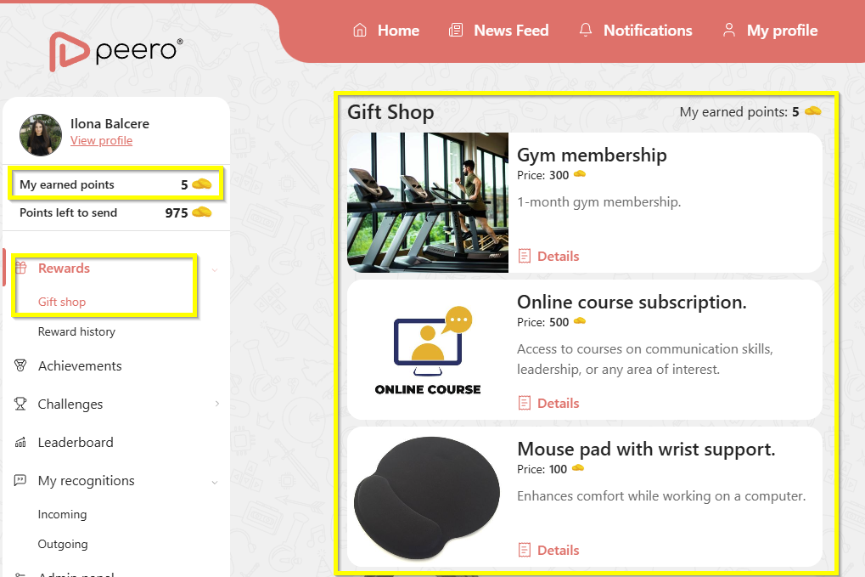
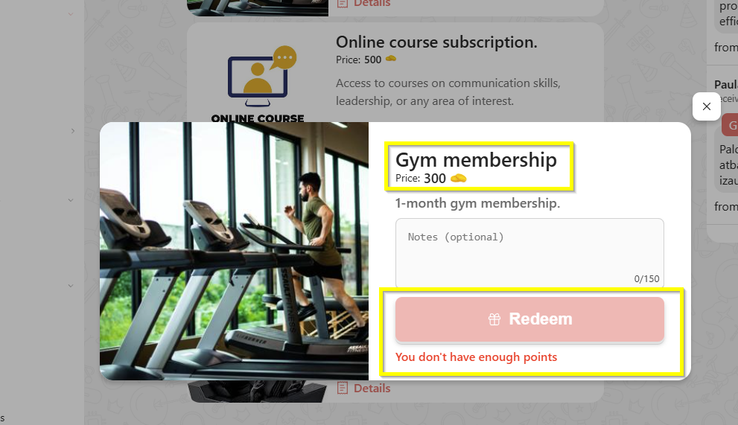

Spending Your Coins
You can spend the coins you receive in the Gift Shop! Choose the gift you like with a price you can afford (my received points) and click Purchase. Please note – the number of gifts is limited!

Slide 13

Earning Extra Coins

Slide 14
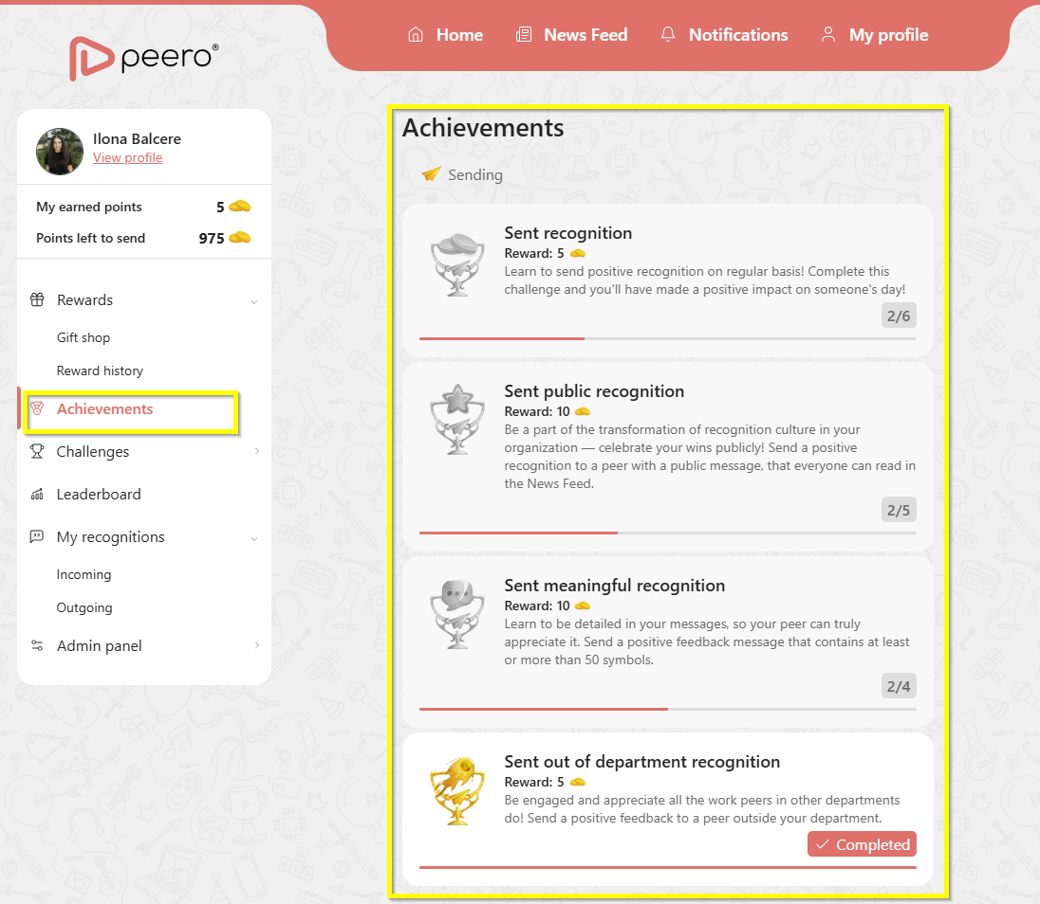
Track Your Achievements
Enhance your skills in sending, receiving, and engaging with recognitions by completing achievements!
By fulfilling the conditions specified for each achievement, you will also receive a reward – additional coins!

Slide 15
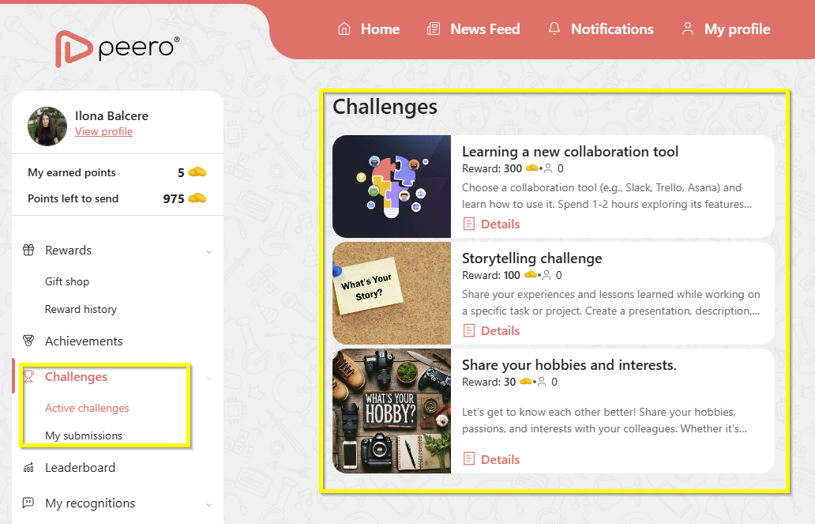
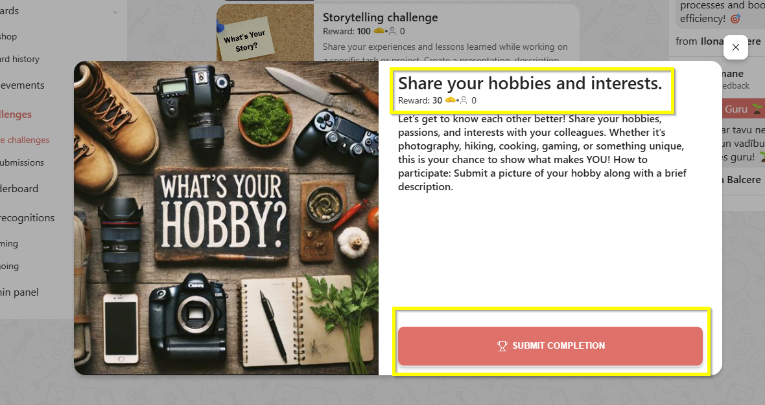
Complete Challenges
Strengthen values important to you and the organization by completing one of the available challenges! Fulfill the conditions specified for the challenge, submit the required proof of completion, and receive additional coins as a reward for spending in the gift shop.

Slide 16
Peero Support
If you encounter any technical issues with using the platform or have any other Peero-related questions, please feel free to reach out.
Name Surname – email

